Slide 1
Educational Inequity in Davidson County
Amanda Julie Partlow

Slide 2
Motivation
Been in a unique position in education for a decade in Chattanooga
Job required me to see all different kinds of school in different areas
Selected project before the protests, but great timing
I believe education is the root cause, and everything else is largely symptomatic
Some of the schools I have been in have been essentially wastes of time, and to think that anyone learns in those environments is zany

Slide 3
Hurtles / Challenges
Finding zone data
Navigating census data
Not familiar with schools here

Slide 4
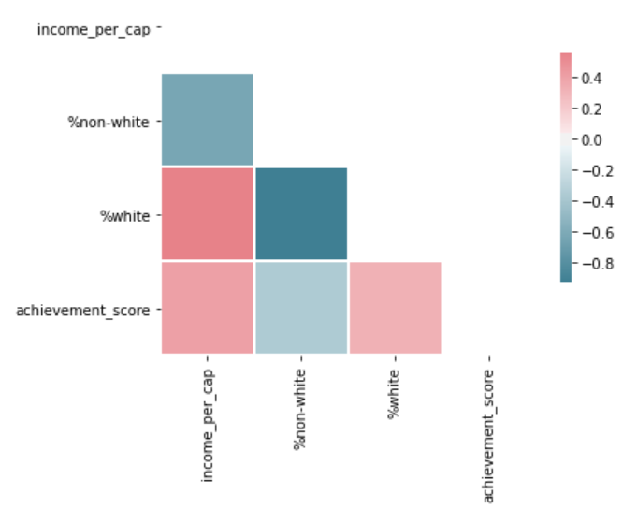
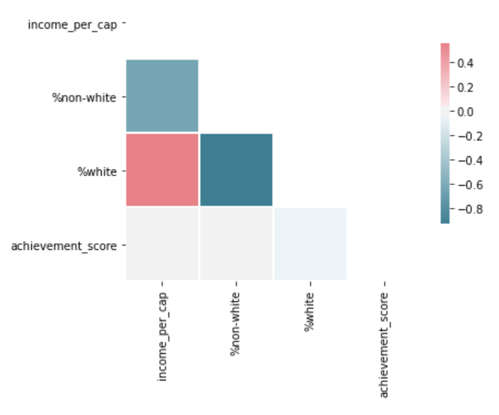
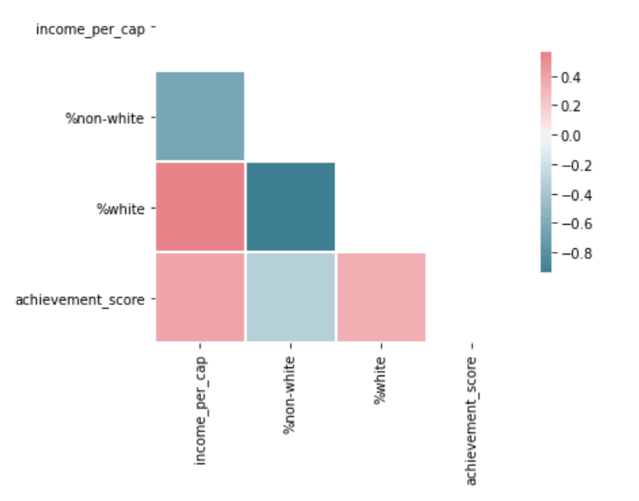
Python Correlations
Elementary Schools
Middle Schools
High Schools

Slide 5
Tableau Map Dashboard

Slide 6
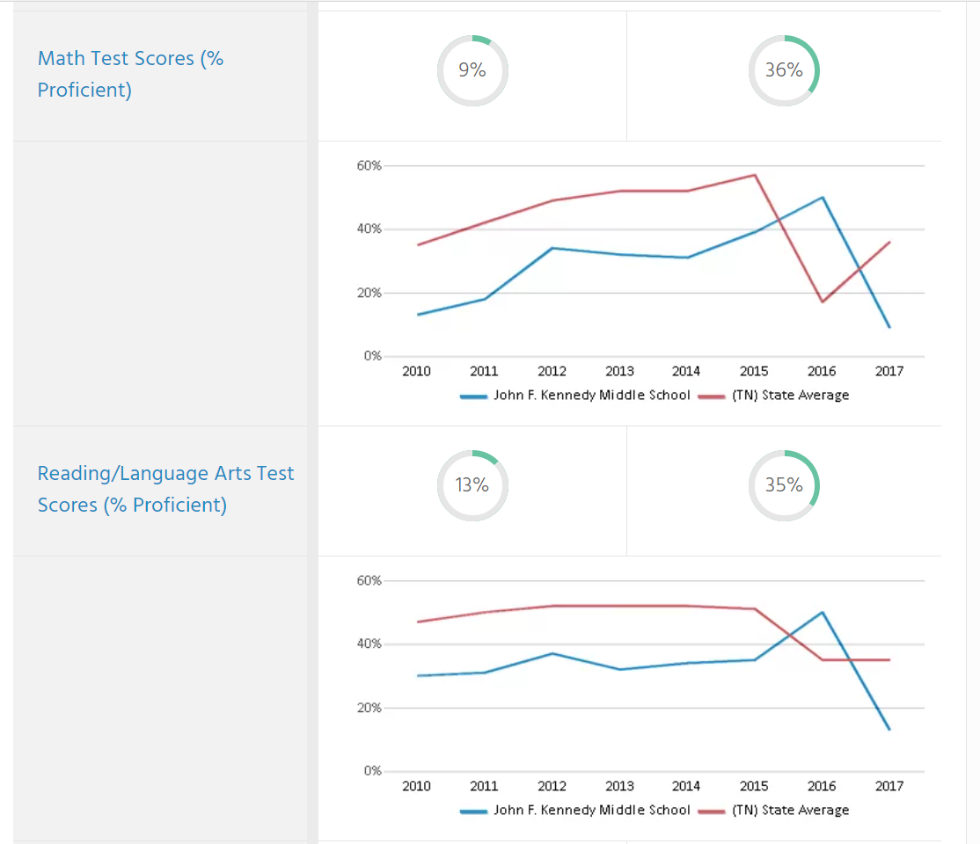
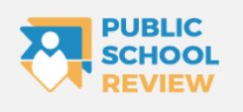
Kennedy Middle School

Slide 7
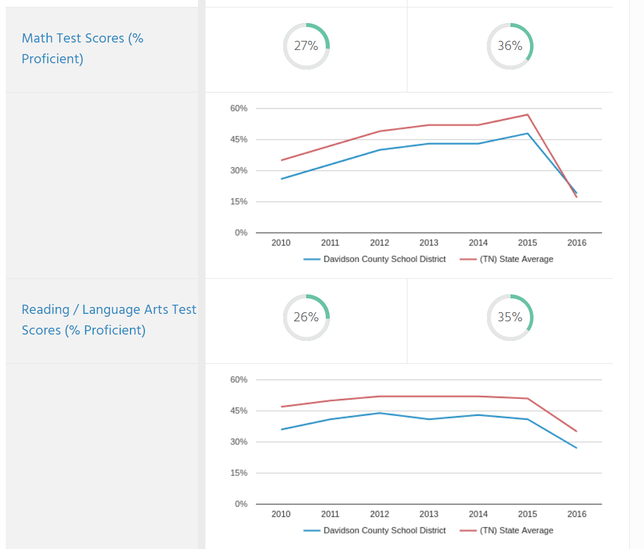
Davidson County

Slide 8
Data Sources
US Census
Tennessee Department of Education

